Slide 1
10

Slide 3
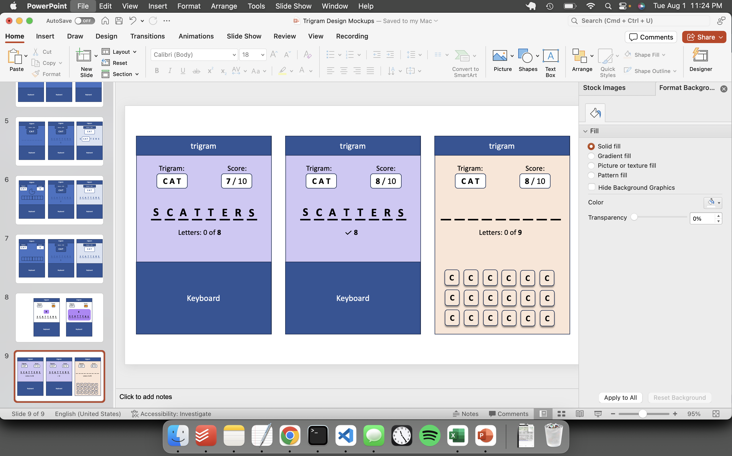

Slide 4
Trigram
Stage I
Trigram
Stage II
Trigram
Longest
C A T
✔
C A T
✔
C A T
10
✔
C A T C H
8
_ _ _ _ _ _ _ _
5
_ _ _ _ _ _
S C A T T E R E D
?
✔
6
_ _ _ _ _ _ _
10
_ _ _ _ _ _ _ _ _ _
CATCHY
Enter word containing CAT
Enter word containing CAT
GO
GO
GO

Slide 5
Trigram
Stage I
Trigram
Stage II
Trigram
Longest
C A T
C A T
✔
C A T
10
4
_ _ _ _ _
8
_ _ _ _ _ _ _ _
5
_ _ _ _ _ _
9
S C A T T E R E D
?
6
_ _ _ _ _ _ _
10
_ _ _ _ _ _ _ _ _ _
CATCHY
Enter word containing CAT
Enter word containing CAT
GO
GO
GO

Slide 6
Trigram
Stage I
Trigram
Stage I
C A T
C A T
C A T
4
_ _ _ _ _
4
C A T _ _
4
C A T C H
5
5
5
_ _ _ _ _ _
6
6
6

Slide 7
Trigram
Progress
Trigram
Stage I
Trigram
Stage I
C A T
C A T
C A T
4
_ _ _ _ _
4
C A T _ _
4
C A T C H
5
5
5
_ _ _ _ _ _
6
6
6

Slide 8
Trigram
Stage I
Trigram
Stage I
Trigram
Stage I
C A T
C A T
C A T
4
_ _ _ _
4
C A _ _
4
C A T S
5
5
5
6
6
6
Trigram
Stage I
Trigram
Stage I
Trigram
Stage I
C A T
C A T
C A T
4
C A T S
4
C A T S
4
C A T S
5
_ _ _ _ _
5
C A T C _
5
C A T C H
6
6
6
Trigram
Stage I
Trigram
Stage I
Trigram
Stage I
C A T
C A T
C A T
4
C A T S
4
C A T S
4
C A T S
5
C A T C H
5
C A T C H
5
C A T C H
6
_ _ _ _ _ _
6
C A T _ _ _
6
C A T C H Y
Trigram
Stage I
C A T
4
C A T S
5
C A T C H
6
C A T C H Y

Slide 9
Trigram
Stage I
Trigram
Stage I
Trigram
Stage I
C A T
C A T
C A T
7
_ _ _ _ _ _ _
7
S C A T _ _ _
7
C A T S
5
5
5
6
6
6
Trigram
Stage I
Trigram
Stage I
Trigram
Stage I
C A T
C A T
C A T
7
C A T S
7
S C A T T E R
7
C A T S
5
_ _ _ _ _
8
S C A T T _ _ _
5
C A T C H
6
6
6
Trigram
Stage I
Trigram
Stage I
Trigram
Stage I
C A T
C A T
C A T
7
C A T S
7
S C A T T E R
7
C A T S
5
C A T C H
8
S C A T T E R S
5
C A T C H
6
_ _ _ _ _ _
9
S C A _ _ _ _ _ _
6
C A T C H Y
Trigram
Stage I
C A T
4
C A T S
5
C A T C H
6
C A T C H Y

Slide 10
Trigram
Stage I
Trigram
Stage I
Trigram
Stage I
C A T
C A T
C A T
7
_ _ _ _ _ _ _
7
S C A T _ _ _
7
C A T S
5
5
5
6
6
6
Trigram
Stage I
Trigram
Stage I
Trigram
Stage I
C A T
C A T
C A T
7
C A T S
7
S C A T T E R
7
C A T S
5
_ _ _ _ _
8
S C A T T _ _ _
5
C A T C H
6
6
6
Trigram
Stage I
Trigram
Stage I
Trigram
Stage I
C A T
C A T
C A T
7
C A T S
7
S C A T T E R I N G
7
C A T S
5
C A T C H
8
S C A T T E R S
5
C A T C H
6
_ _ _ _ _ _
9
S C A _ _ _ _ _ _
6
C A T C H Y
Trigram
Stage I
C A T
4
C A T S
5
C A T C H
6
C A T C H Y

Slide 11
Trigram
Stage I
Trigram
Stage I
Trigram
Stage I
C A T
C A T
C A T
4
_ _ _ _
4
C A _ _
4
C A T S
5
5
5
6
6
6
Trigram
Stage I
Trigram
Stage I
Trigram
Stage I
C A T
C A T
C A T
4
C A T S
4
C A T S
4
C A T S
5
_ _ _ _ _
5
C A T C _
5
C A T C H
6
6
6
Trigram
Stage I
Trigram
Stage I
Trigram
Stage I
C A T
C A T
C A T
4
C A T S
4
C A T S
4
C A T S
5
C A T C H
5
C A T C H
5
C A T C H
6
_ _ _ _ _ _
6
C A T _ _ _
6
C A T C H Y
Trigram
Stage I
C A T
4
C A T S
5
C A T C H
6
C A T C H Y

